Slide 1


Hydrodynamics Modeling
UNCLASSIFIED
Todd Steissberg
U.S. Army Engineer Research and Development Center, Environmental Laboratory
CE-QUAL-W2 Workshop, 2024
July 08 – 09, 2024
Environmental Systems
Modeling Team
UNCLASSIFIED

Slide 2
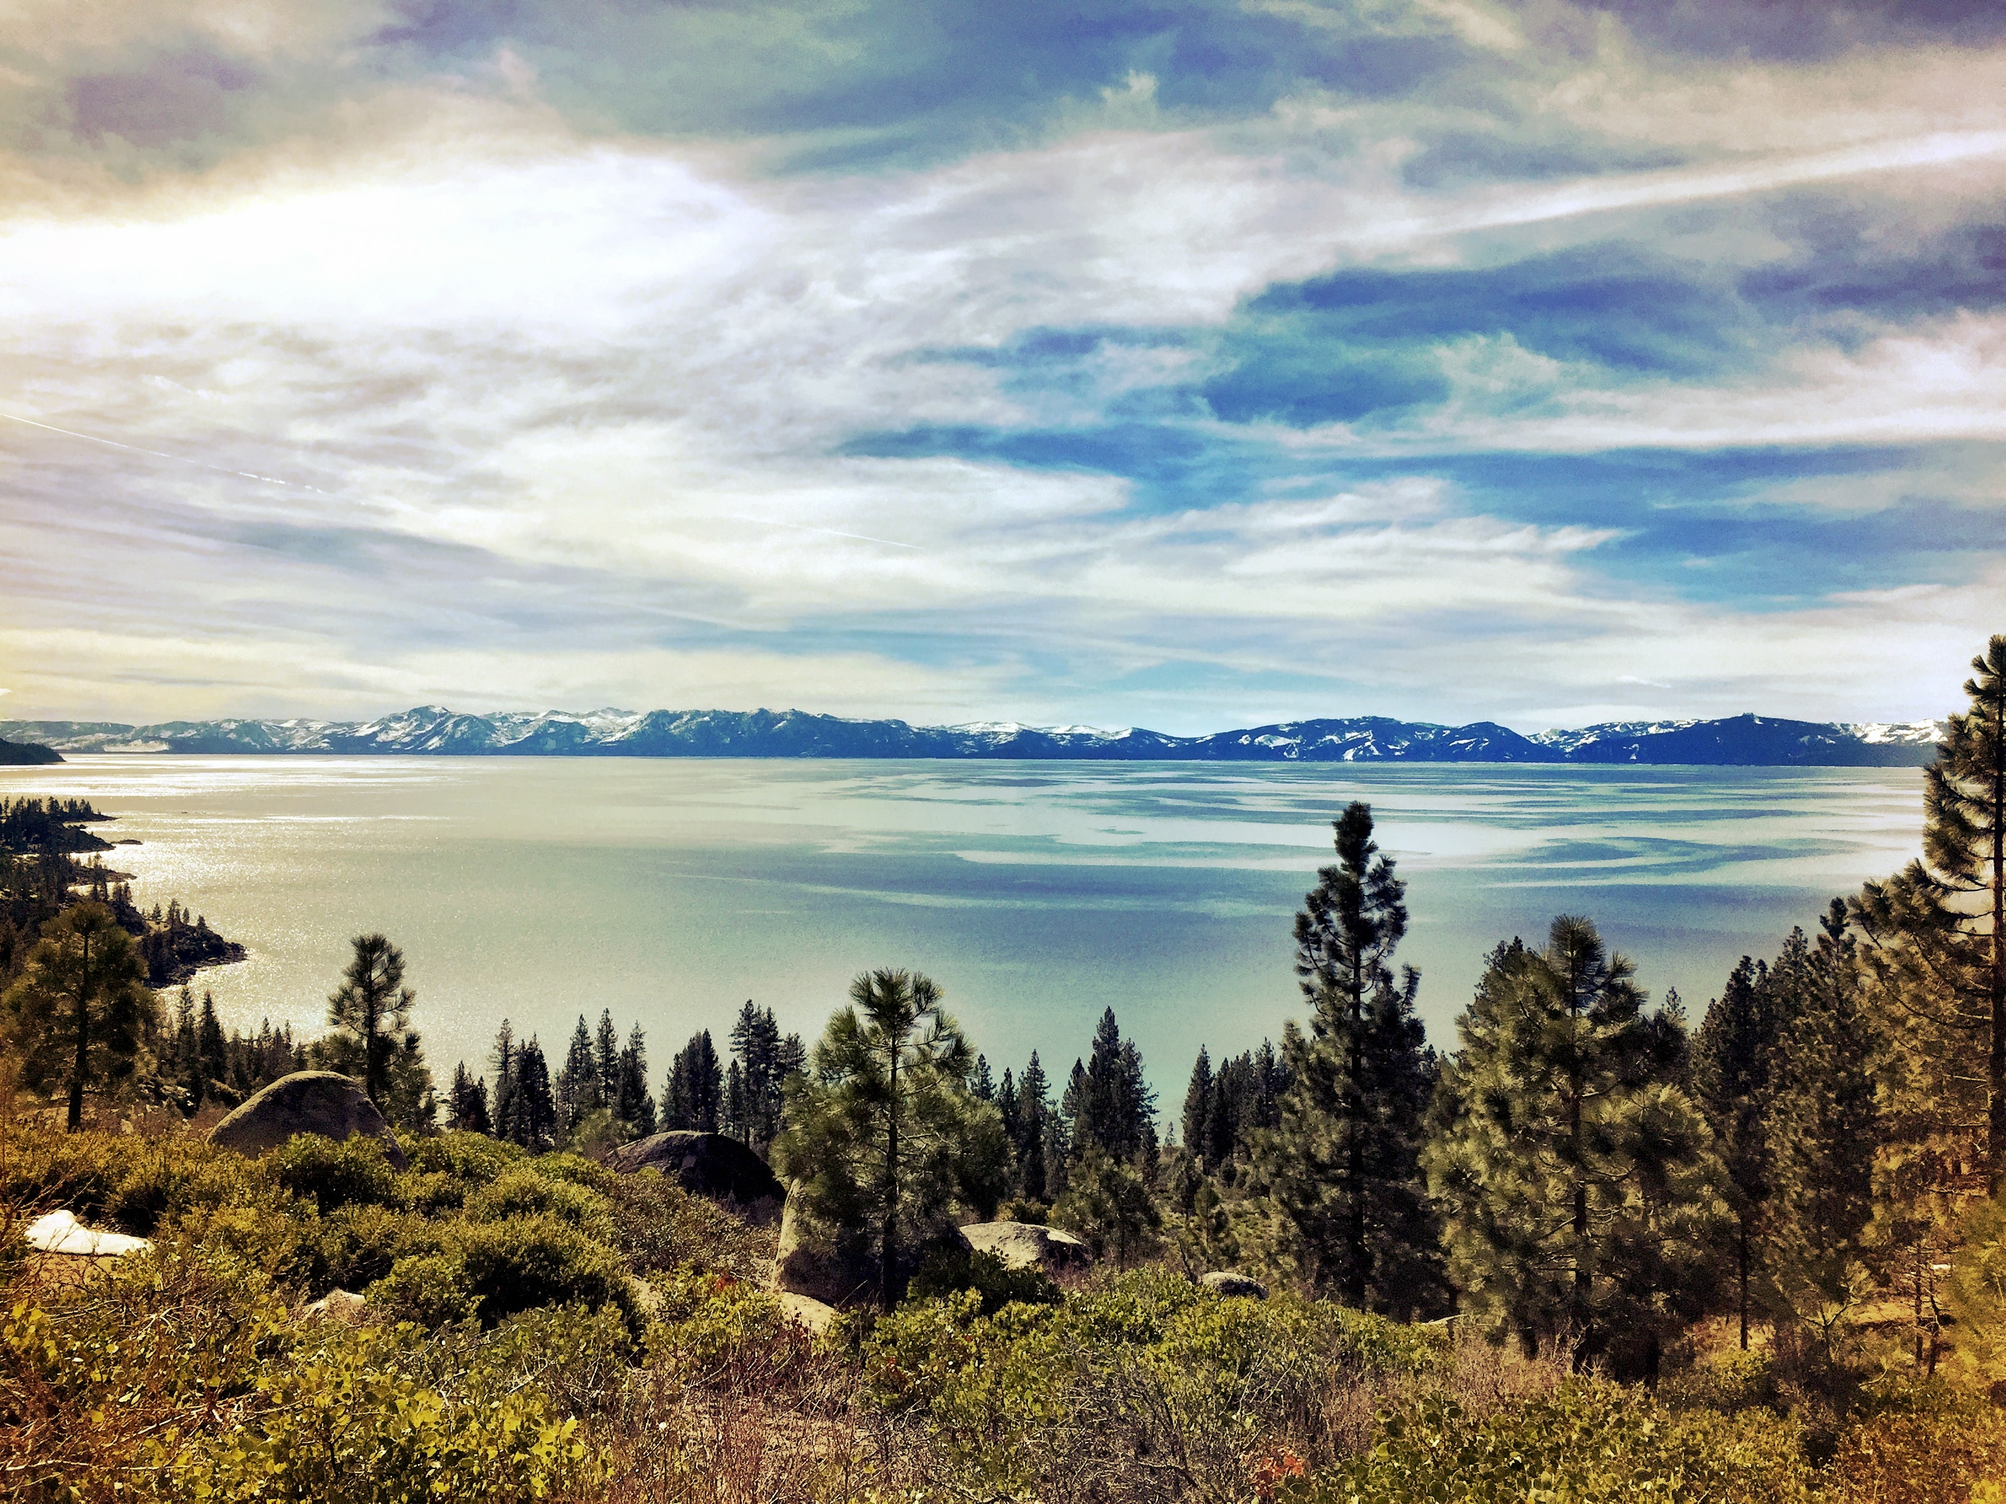
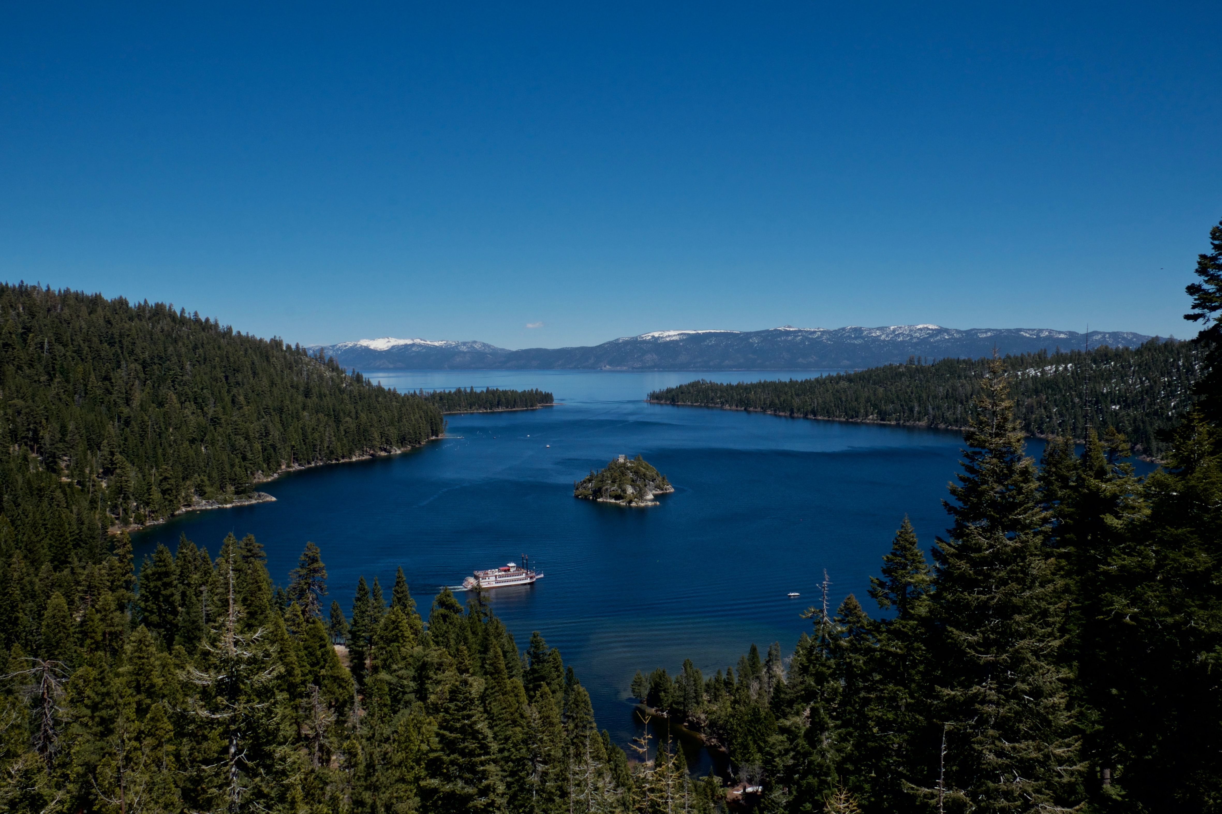
Important Hydrodynamic Processes
Vertical stratification
Meteorology
Wind forcing
Thermal forcing
Water quality
Affects stratification
Climate
Long-term effects

Slide 3
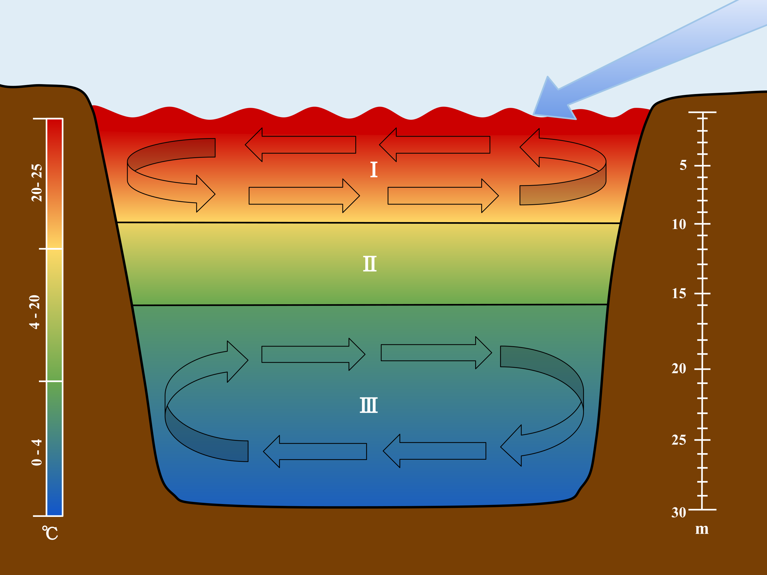
Vertical Stratification
Mid-latitude lakes and reservoirs tend to thermally stratify vertically during the spring and summer. A conceptual model of their stratification divides the water body into three vertical layers:
The epilimnion, a warm surface layer
The hypolimnion, a cool bottom layer
The metalimnion, the layer in between the top and bottom layers. This layer is often described as the thermocline, where the temperature suddenly decreases sharply with depth.
Lake stratification varies continually. It is often described by the depth and strength of the thermocline. The seasonal thermocline is characterized by the average depth and strength over a season. The diurnal thermocline varies throughout the day.

Slide 4
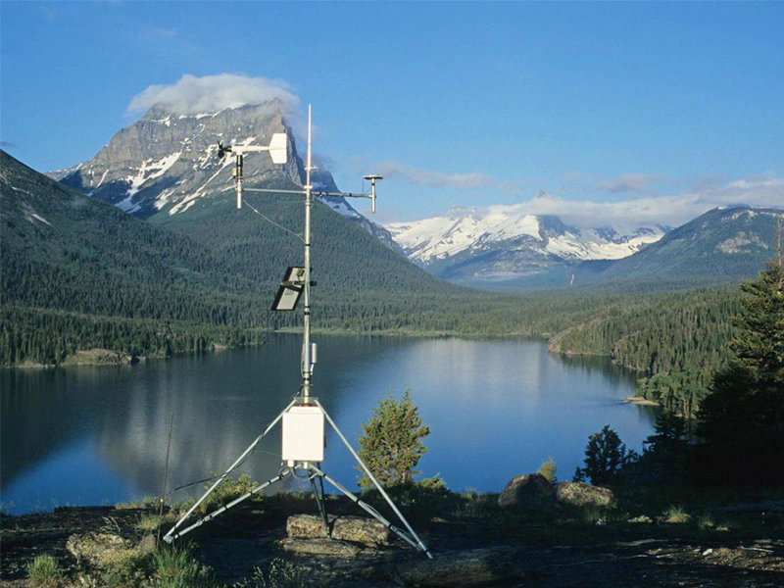
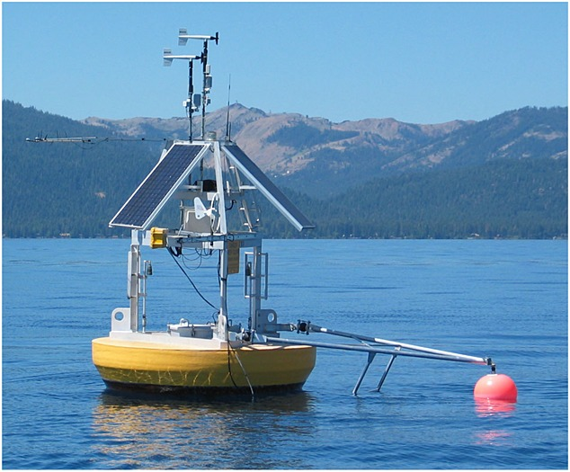
Meteorological Forcing
The meteorology of the watershed affects several factors that control the hydrodynamics as well as the water quality of a reservoir.
Wind forcing: The wind flowing across the reservoir affects depth of stratification, vertical mixing, and circulation (currents across and around the water body).
Heat balance: The incoming (shortwave) solar radiation and outgoing radiation (longwave radiation, sensible heat, and evaporation) control the heat balance. Wind, solar radiation, and cloud cover, and relative humidity control the evaporation, the largest source of heat loss in a water body.

Slide 5
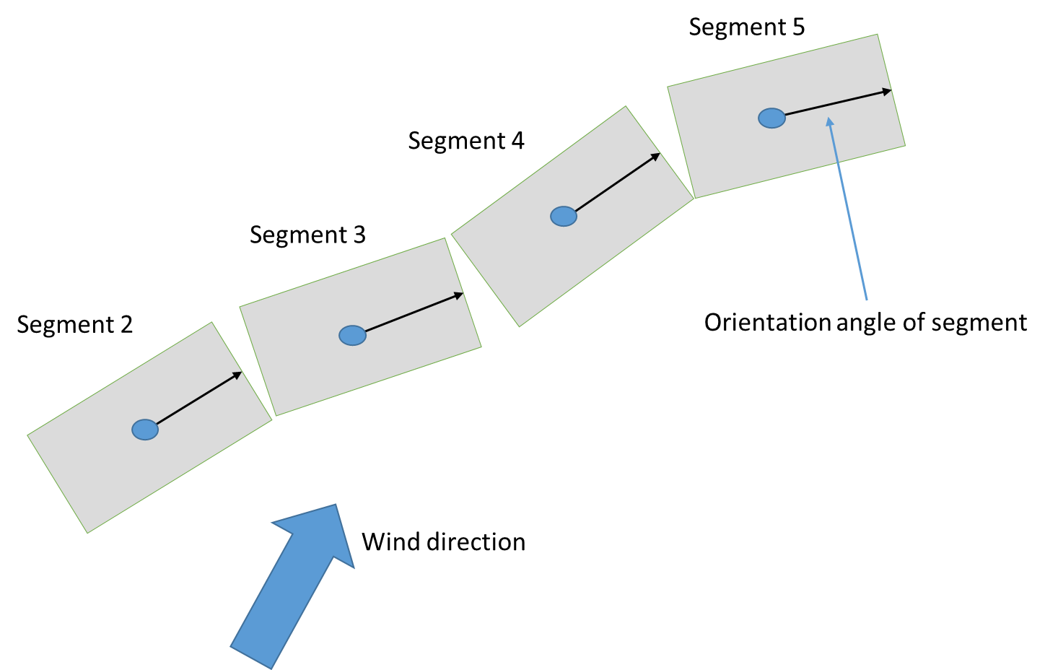
Meteorological Forcing: Wind Fetch
The fetch or fetch length of a water body is the length of water over which wind has blown without obstruction.
The fetch varies with the direction of the wind.
If the fetch of the prevailing wind is aligned with the long axis of the water body, then the wind effect on mixing is at its maximum.

Slide 6
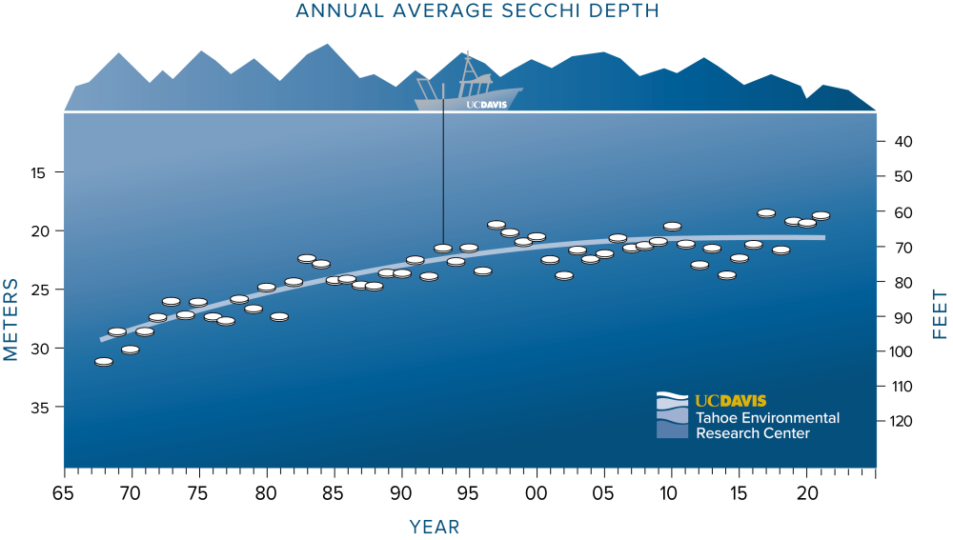
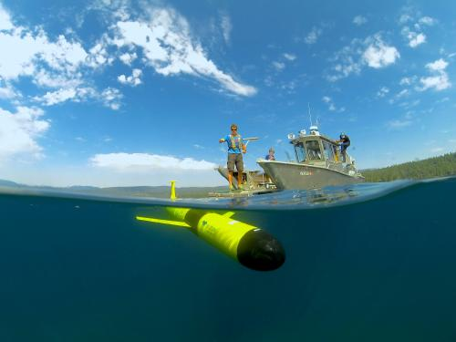
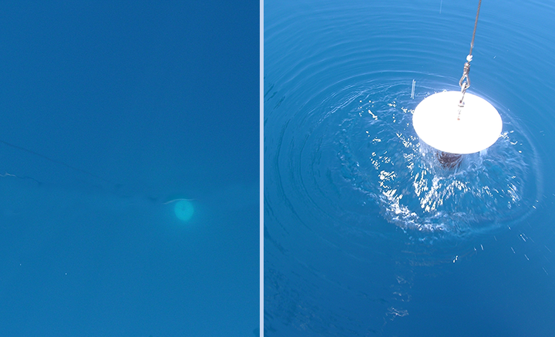
Water Quality Forcing
Water quality affects the clarity of the water.
Water clarity affects the depth that solar radiation penetrates the water surface.
Clear lakes tend to have deep and relatively cool epilimnions and weak stratification.
Turbid lakes tend to have shallow and warm epilimnions and strong stratification.

Slide 7

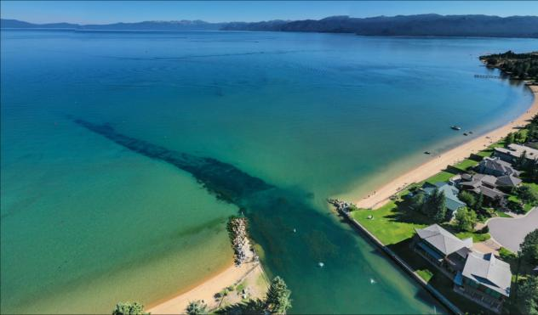
Climate Forcing
Climate change can have a significant affect on reservoir hydrodynamics.
As climate and water temperatures increase, while average wind forcing remains the same, the seasonal stratification will tend to strengthen. This can reduce the tendency of the reservoir to overturn (mix vertically). Poor water quality conditions can intensify in the hypolimnion.
Example: In Lake Tahoe, a significant quantity of phosphorus is bound with iron in the sediment. Hypoxic conditions could release the phosphorus into the water column, resulting in significant internal loading of phosphorus, increasing algae concentrations.
On the other hand, if climate change increases the strength and frequency of occurrence of intense storms, wind forcing will affect the diurnal stratification. However, extreme precipitation can lead to increased particle inputs from runoff and erosion, which may decrease water clarity.

Slide 8
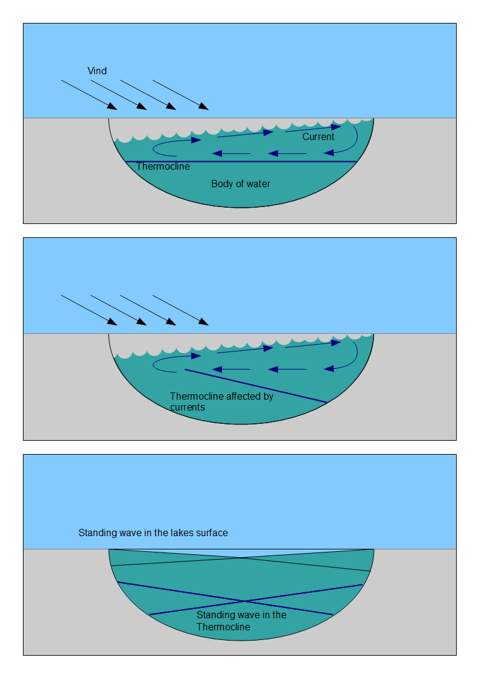
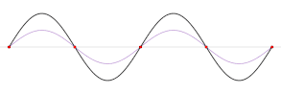
Seiches
As wind blows across the water surface, it causes the water surface to tilt. It rises at the downwind side and lowers at the downwind side.
The elevation change is small. For a water body with a fetch of 10 km, the maximum elevation change at the upwind end is only a few centimeters.
When the wind slows down, the water surface tilts in the opposite direction, but it moves past the equilibrium point. This cycle results in a basin-wide standing wave, called a seiche.
Seiches, like other surface waves are relatively fast and shallow.

Slide 9
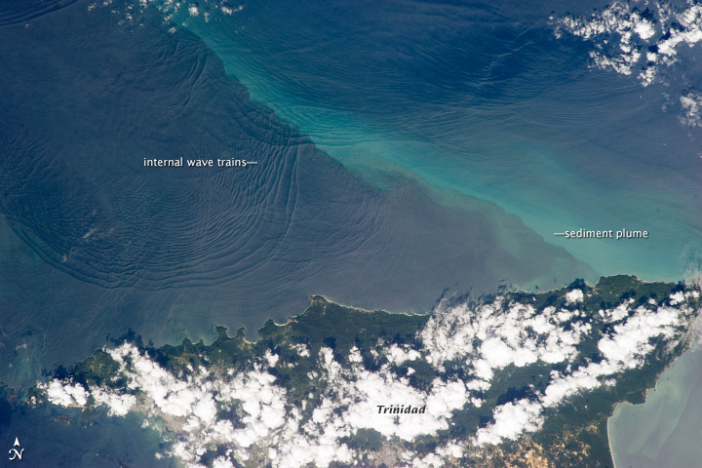
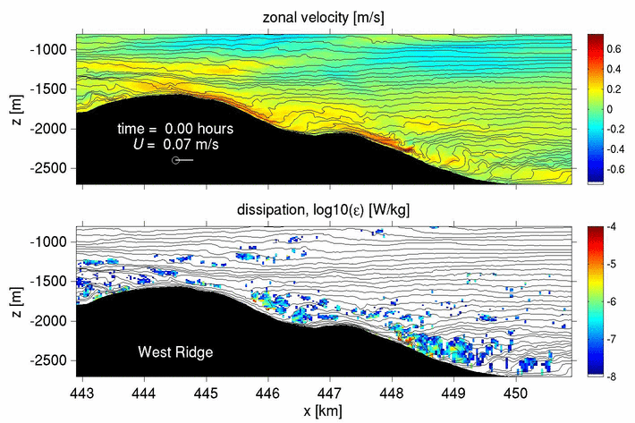
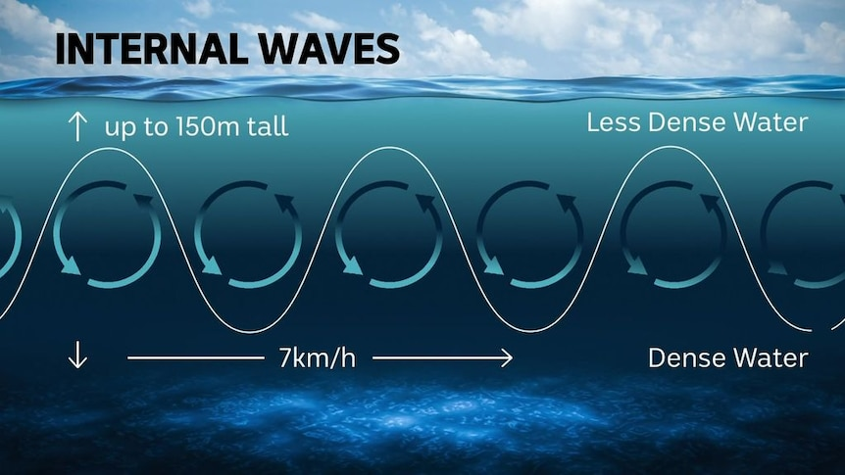
Internal Waves
The thermocline can oscillate up and down in response to seicheing, generating internal waves.
The smaller the density difference between two layers of fluid, the larger and slower the waves.
Seiches are small and fast.
Internal waves are large and slow.
Even though they are under the surface, they can be seen from the air and from space.

Slide 10
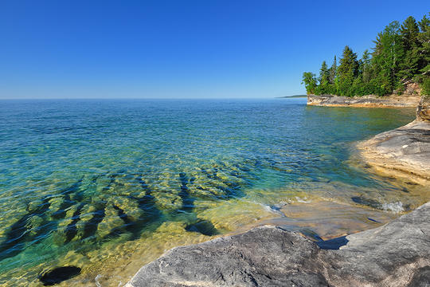
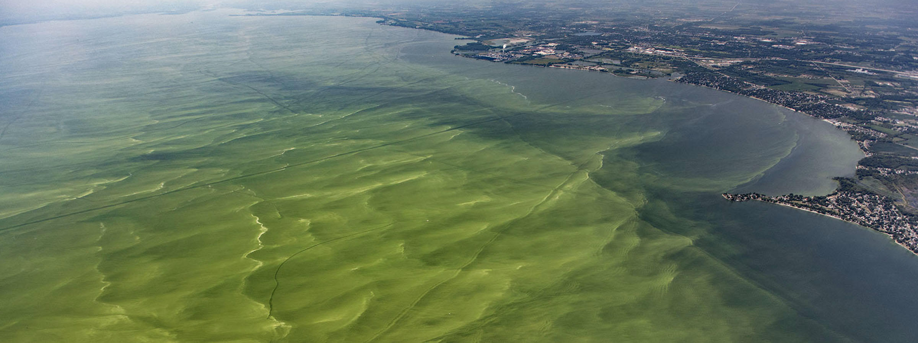
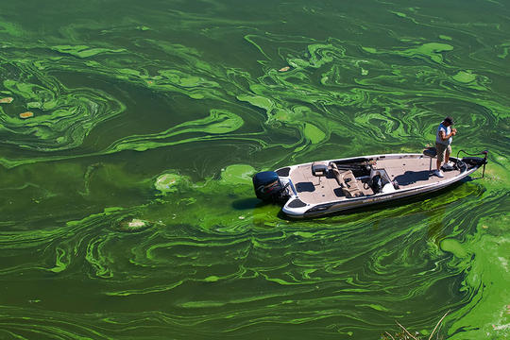
Harmful Algal Blooms
Conditions that lead to Harmful Algal Blooms (HAB) include:
Warm water temperatures
High nutrient and algae concentrations
Low flows and velocities (currents, mixing)
Climate change is expected to generally increase surface water temperatures, which will increase vertical stratification.
These factors are expected to increase the severity and frequency of occurrence of harmful algal blooms in the future.

Slide 11
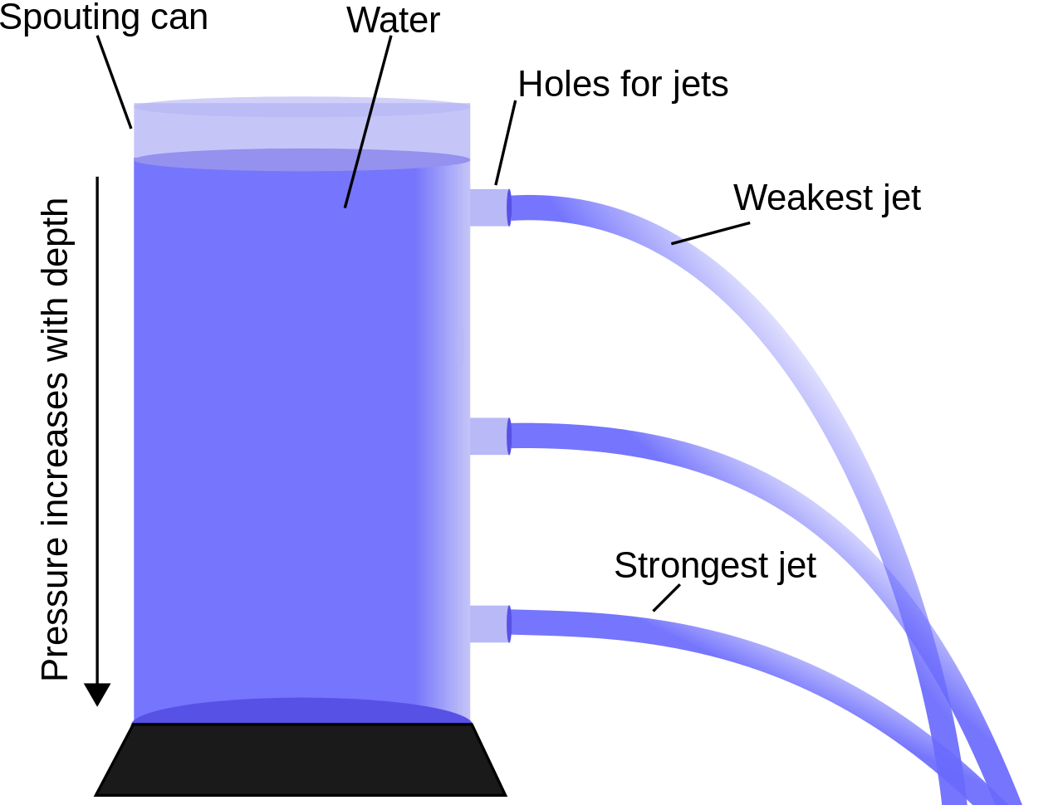
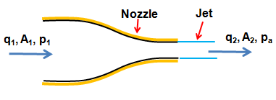
Introduction to Fluid Dynamics
Important Properties:
Flow, Q
Velocity, V
Area, A
Pressure, P
Density, ρ
Height of water body: controls potential energy, H or z
Depth within water body: controls pressure, D or z
Viscosity, ν
Three laws of conservation:
Conservation of Mass
Conservation of Momentum
Conservation of Energy (not covered)

Slide 12
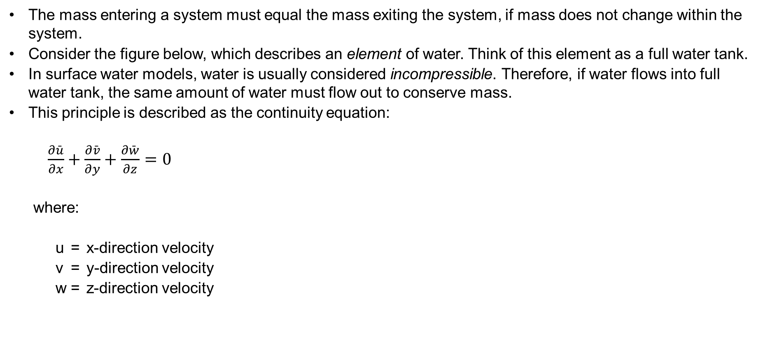
Conservation of Mass: Continuity Equation
The mass entering a system must equal the mass exiting the system, if mass does not change within the system.
Consider the figure below, which describes an element of water. Think of this element as a full water tank.
In surface water models, water is usually considered incompressible. Therefore, if water flows into full water tank, the same amount of water must flow out to conserve mass.
This principle is described as the continuity equation:
$\frac{∂\bar{u}}{∂x}+\frac{∂\bar{v}}{∂y}+\frac{∂\bar{w}}{∂z}=0$
where:
u = x-direction velocity
v = y-direction velocity
w = z-direction velocity

Slide 13
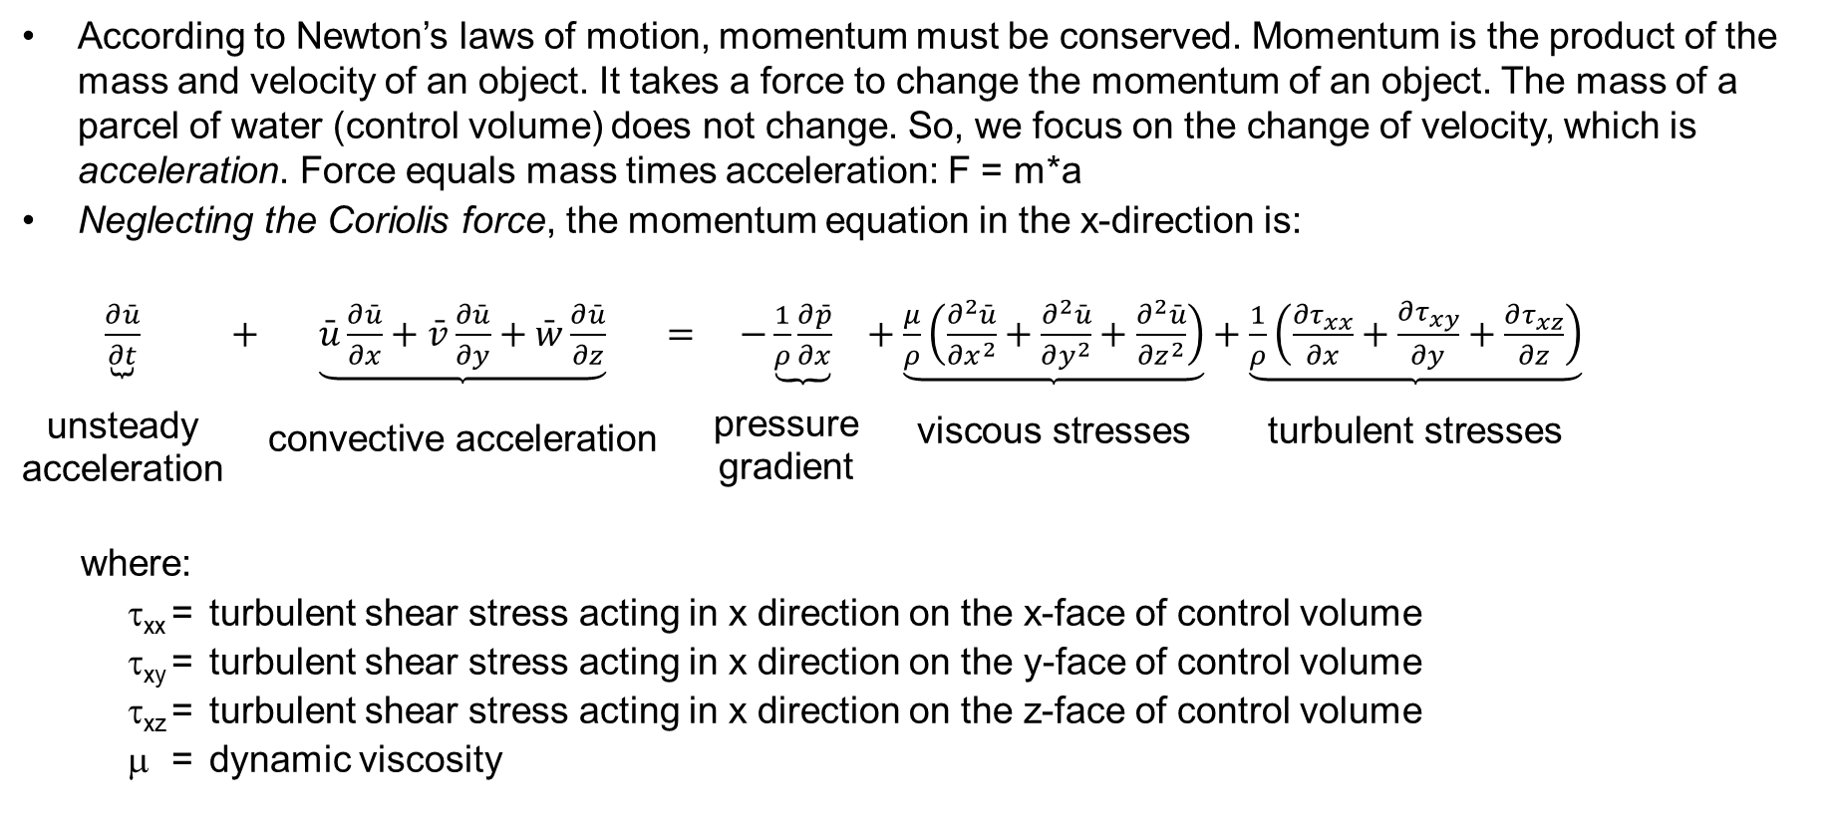
Conservation of Momentum: Momentum Equations
According to Newton’s laws of motion, momentum must be conserved. Momentum is the product of the mass and velocity of an object. It takes a force to change the momentum of an object. The mass of a parcel of water (control volume) does not change. So, we focus on the change of velocity, which is acceleration. Force equals mass times acceleration: F = m*a
Neglecting the Coriolis force, the momentum equation in the x-direction is:
$\underset{\begin{aligned} \\ \text{unsteady} \\ \text{acceleration}\end{aligned}}{\underbrace{\frac{∂\bar{u}}{∂t}}}+\underset{\begin{aligned} \\ \\ \text{convective} \text{acceleration}\end{aligned}}{\underbrace{\bar{u}\frac{∂\bar{u}}{∂x}+\bar{v}\frac{∂\bar{u}}{∂y}+\bar{w}\frac{∂\bar{u}}{∂z}}}= \underset{\begin{aligned} \\ \text{pressure} \\ \text{gradient}\end{aligned}}{−\underbrace{\frac{1}{ρ}\frac{∂\bar{p}}{∂x}}}+\underset{\begin{aligned} \\ \text{viscous} \text{stresses}\end{aligned}}{\underbrace{\frac{μ}{ρ}\left(\frac{∂^{2}\bar{u}}{∂x^{2}}+\frac{∂^{2}\bar{u}}{∂y^{2}}+\frac{∂^{2}\bar{u}}{∂z^{2}}\right)}}+\underset{\begin{aligned} \\ \text{turbulent} \text{stresses}\end{aligned}}{\underbrace{\frac{1}{ρ}\left(\frac{∂τ_{xx}}{∂x}+\frac{∂τ_{xy}}{∂y}+\frac{∂τ_{xz}}{∂z}\right)}}$
where:
τ_{xx} = turbulent shear stress acting in x direction on the x-face of control volume
τ_{xy} = turbulent shear stress acting in x direction on the y-face of control volume
τ_{xz} = turbulent shear stress acting in x direction on the z-face of control volume
μ = dynamic viscosity

Slide 14

Questions?

